Slide 1

2023
Notes:
INFORMATION FOR INSTRUCTORS
Slide notes are intended as aids for delivering and supplementing slide content.
See the “Classes” tab of the ‘Lesson Plans’ worksheet (Google Drive) for the detailed breakdown of slides for each module/part. This includes estimated time (hours) to devote to each slide, with sums at daily and module/part level.
Slide Notes that include a “QUIZ” caption may have animation effects (fly-ins) for displaying the answer after the class has had an opportunity to reply. If present, the number of fly-ins is indicated in a “FLY-INS” caption in the Slide Notes. (See the “Slide Notes” tab of the Google sheet for other captions used.)
Instructors may add slides or content, if required, but should have new material approved before delivery.
Instructors should plan to supplement slide content with whiteboard illustrations and class discussion.
Engaging comprehension checks should be performed frequently. Slide notes contain some suggestions already; instructors should add their own.
Instructors are encouraged to mention practical examples from their own experience and to invite students to do the same.
Most labs have IPython notebook starter files and were developed using Jupyter Notebooks. Other labs have been designed to be executed in an IPython (or other) IDE.
Support should be provided for managing conda environments (command-line and Anaconda Navigator.) Students who choose not to use Anaconda should be competent at managing Python environments by their preferred means.

Slide 2
Data Science and AI
Module 1
Part 1:
Mathematics & Statistics

Slide 3
Agenda: Module 1 Part 1
Linear algebra
Calculus
Multivariable calculus
Statistics
Probability
Notes:
MENTION: This part (1st half of Module 1) is the most dense with theoretical content. Part 2 and further modules will have more emphasis on practice than theory. Calculus and linear algebra are important to data scientists for several reasons: they are used extensively in algorithm development; they introduce concepts that scientific programming is built on; and they train us to attack problems in a reductionist, deterministic, theoretically sound manner.

Slide 4
What is Linear Algebra and why is it important for Data Science?
Linear Algebra is the branch of mathematics that deals with linear equations and their representations
Linear Algebra is used extensively in science and engineering to ‘model’ many systems such as in economics, health and finance
Although many systems are ‘non-linear’, Linear Models can be effective first-order approximation. This is crucial, because non-linear models are very difficult to represent and manipulate.
One excellent way to better understand Linear Algebra is use the geometrical representations of its constructs
Another way to better understand Linear Algebra is through programming. This is crucial for a Data Scientist.
Key constructs of Linear Algebra are: Scalar, Vector, Matrix and Tensor

Slide 5
Linear Algebra
Vectors
definitions
vector arithmetic (adding, subtracting and multiplying vectors), dot products
Matrices
definitions
matrix arithmetic
inverses, determinants, transposes
Solving systems of linear equations
Eigenvalues and eigenvectors

Slide 6
Mapping and usage of Linear Algebra in Data Science
Concept | Definition | Mapping to Data Science | Examples
Scalar | A ‘zero-dimensional’ dataset. A number, value, magnitude. Geometrically, it’s a point on on a line. | A single data point | Age of a customer
Vector | A one-dimension dataset. A two or more values. Geometrically it represent a vector in a plane that has magnitude and direction. | A number of data points (usually about a single entity) | Attributes (or features) of one customer: Age, income, marital status, postcode, …, etc. In Deep Learning a vector could be the input to a Neural Network.
Matrix | A two-dimensional dataset. Geometrically, it represents a transformation of two or more vectors. | A set of observations for multiple entities. A transformation of a dataset from one representation to another. | Information about all customers. In Deep Learning a matrix may represents the mapping and weights on hidden layer.
Tensor | An n-dimensional dataset. | A number of sets of observations | Information about all customers. TensorFlow is built around tensors.

Slide 7
Vectors
def: ?
a directed quantity
examples: ?
displacement (not length)
velocity (not speed)
acceleration
force
weight (not mass)
dimensionality > 1
Notes:
QUESTIONS: (1) def, (2) examples.

Slide 8
Vector Decomposition: 2D
y
v
v_{x} = v cos θ
v_{y} = v sin θ
| v | = (v_{x}² + v_{y}²) ^{1/2}
v_{y}
θ
x
v_{x}
Notes:
WHITEBOARD: alt. syntax for vectors (boldface, overhead bar).
MENTIONS: absolute value is ‘L1 norm’

Slide 9
Vector Addition
A_{x}
in general:
R_{x} = A_{x} + B_{x}
R_{y} = A_{y} + B_{y}
in this example:
R_{x} = A cos α + B
R_{y} = A sin α
θ = tan⁻¹ (R_{y} / R_{x})
A
R
A_{y}
α
θ
B
B_{x}
Notes:
MENTIONS: If A, B are described by components, we don’t need trigonometry to compute R.
QUIZ: (1) Where is Rx? (2) Where is Ry? (3) Can we always eliminate one component (as we did here for By)?

Slide 10
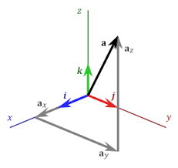
3D Vectors
| a | = (a_{x}² + a_{y}² + a_{z}²) ^{1/2}
Note:
i, j, k are unit vectors
Notes:
MENTIONS: (1) A function is a vector with infinite dimensions. (2) Python and R use ‘vector’ to refer to a column of homogenous data.

Slide 11
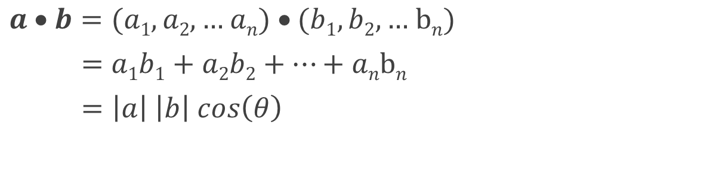
Scalar Multiplication of Vectors
aka inner product, dot product
result is a scalar
Notes:
QUIZ: Can we multiply vectors of different length?
MENTION: (1) cos(0) = 1, so parallel vectors have maximum dot product.
(2) cos(90º) = 0, so orthogonal vectors have 0 dot product.
(3) If two vectors represent term frequency in two docs, dot product measures similarity of docs.
A dot product represents the projection of one vector on another.

Slide 12
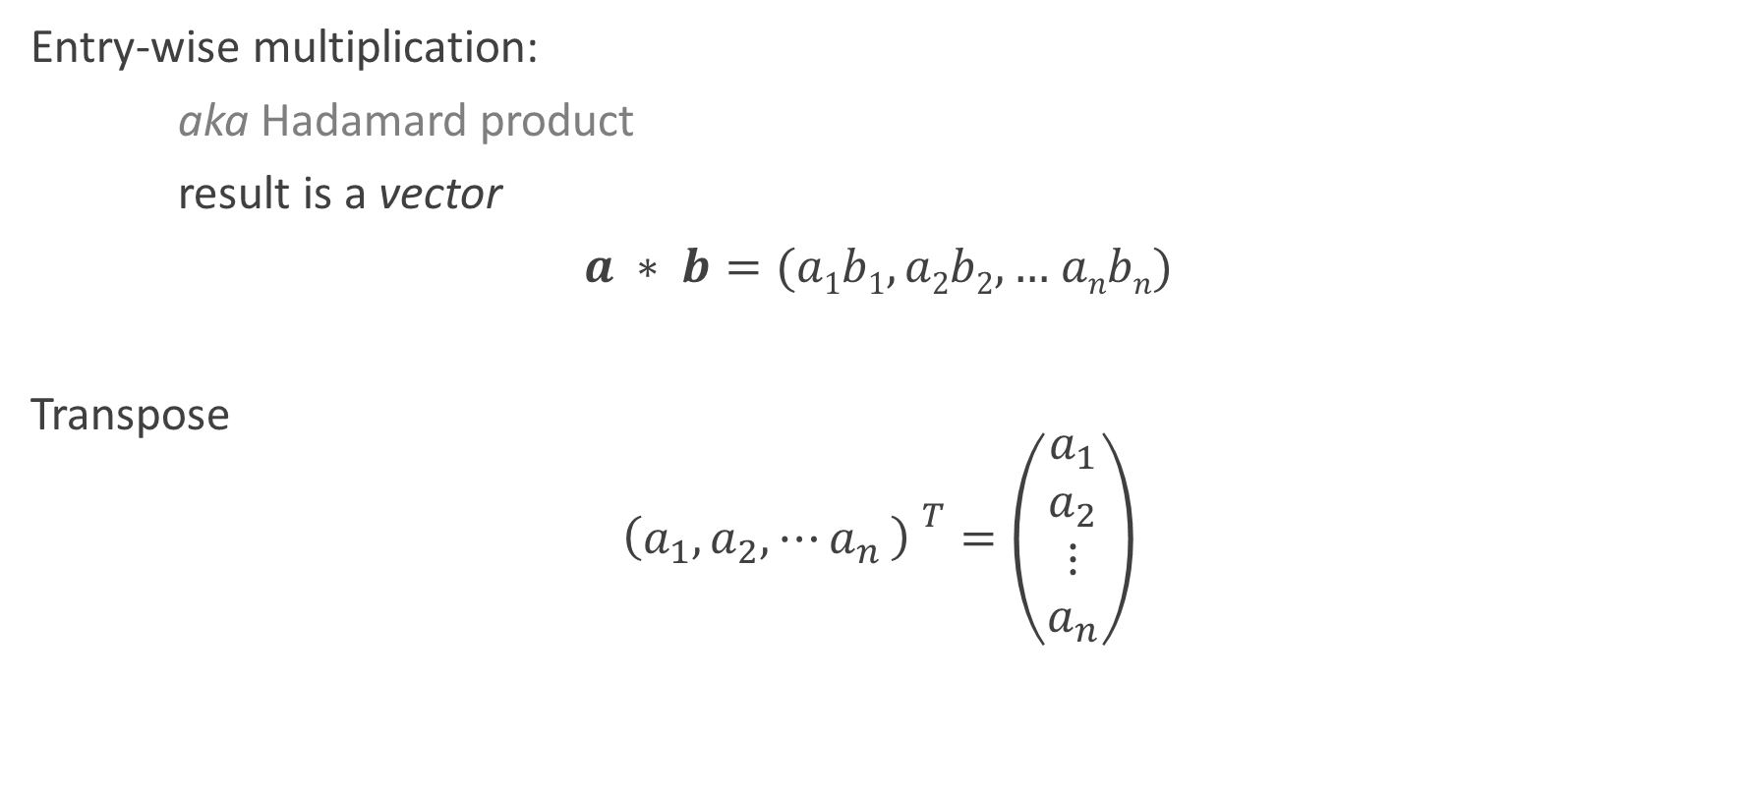
Vector Operations

Slide 13
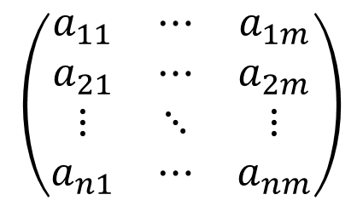
Matrices
def: ?
a rectangular array of numbers
Notes:
QUESTIONS: def (FLY-INS)
EXAMPLES: (1) image / heat map. (2) time series of vectors.

Slide 14
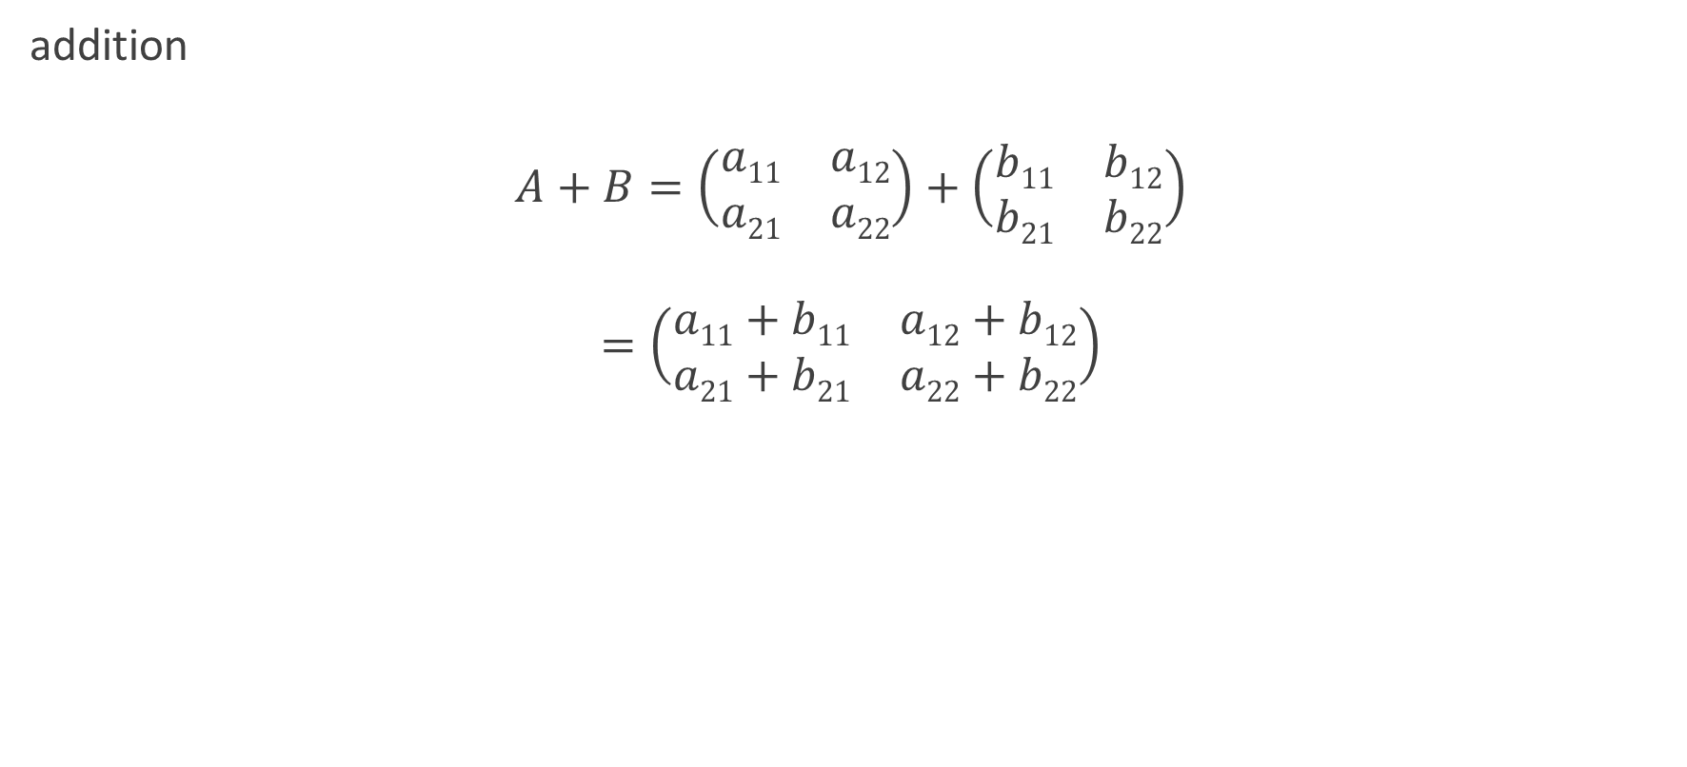
Matrix Arithmetic

Slide 15
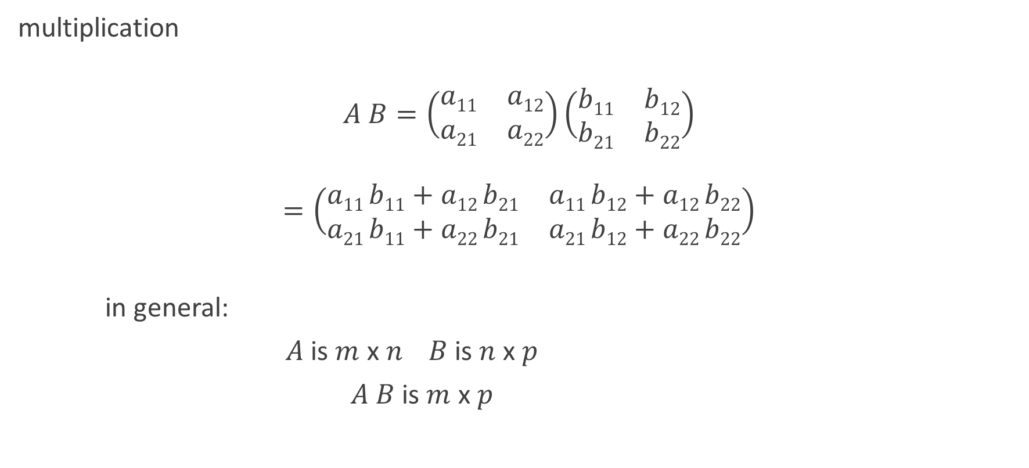
Matrix Arithmetic

Slide 16
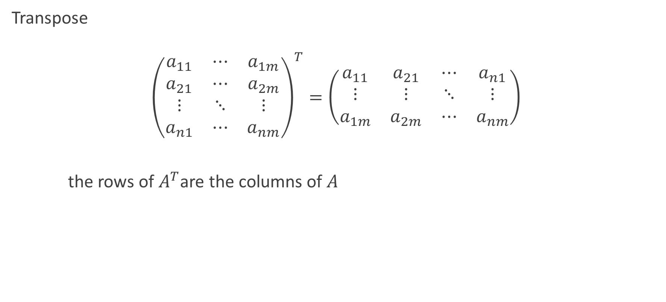
Matrix Operations3

Slide 17
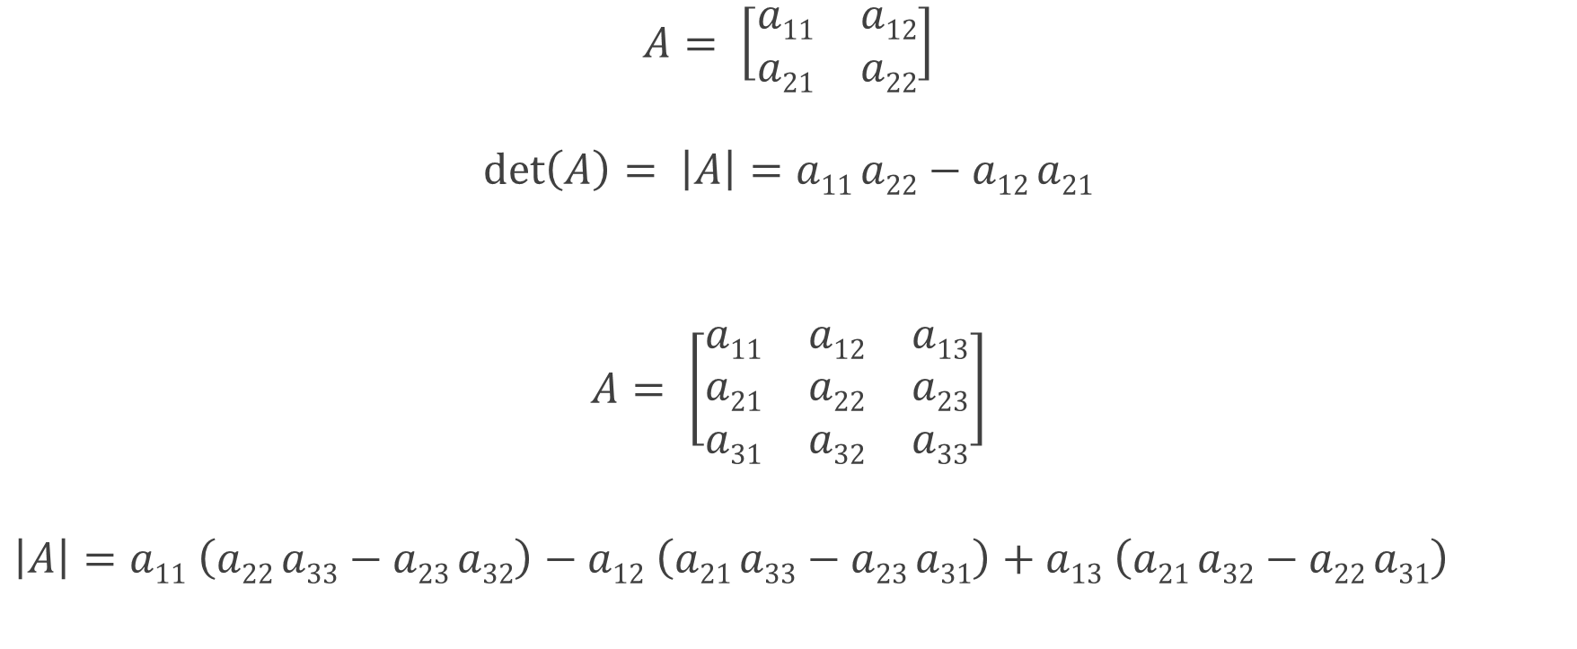
Determinant of a Matrix
Notes:
The determinant is useful for solving linear equations, capturing how linear transformation change area or volume, and changing variables in integrals.

Slide 18
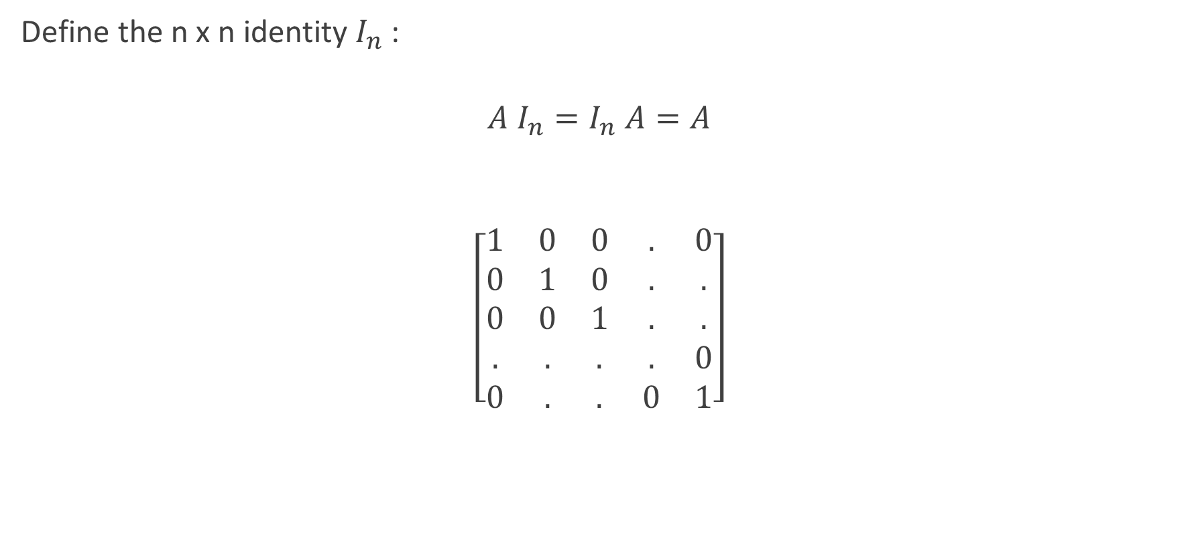
Identity Matrix

Slide 19
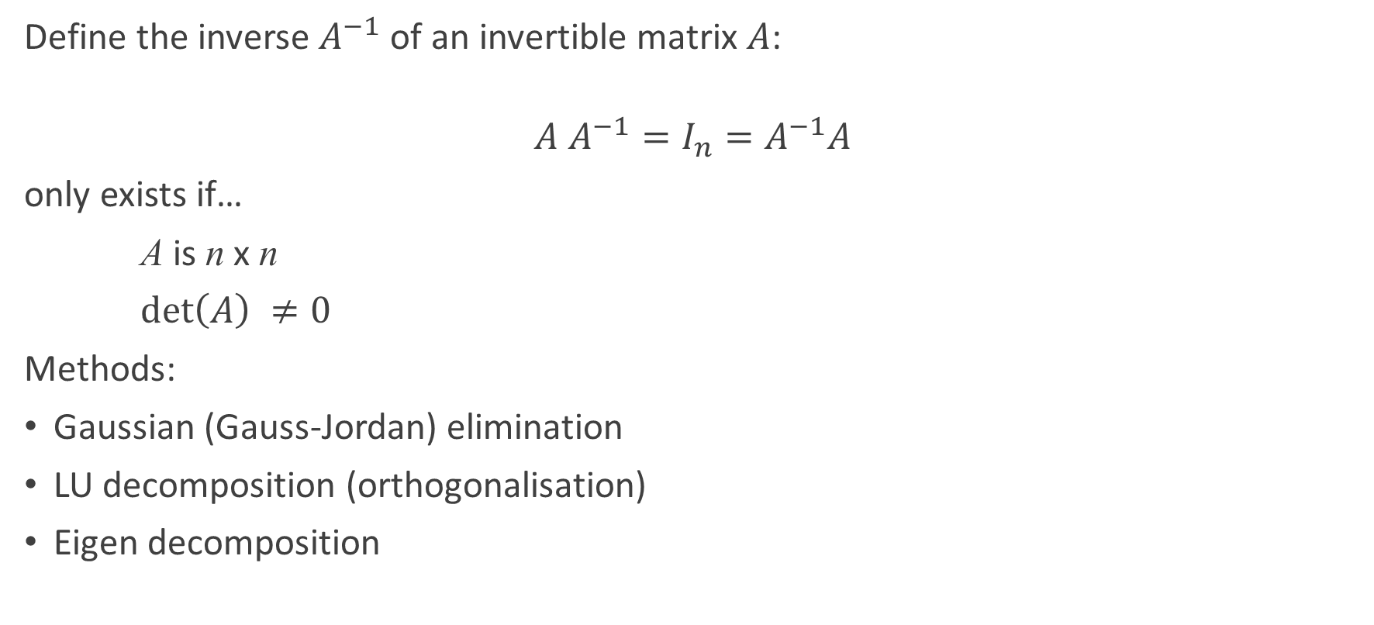
Matrix Inversion

Slide 20
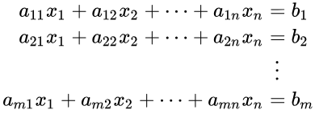
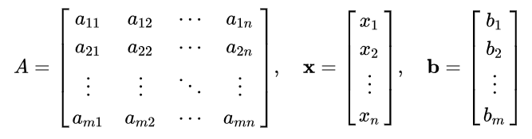

Solving Systems of Linear Equations
Simultaneous linear equations in n unknowns (x_{i}):
in matrix form:

Slide 21
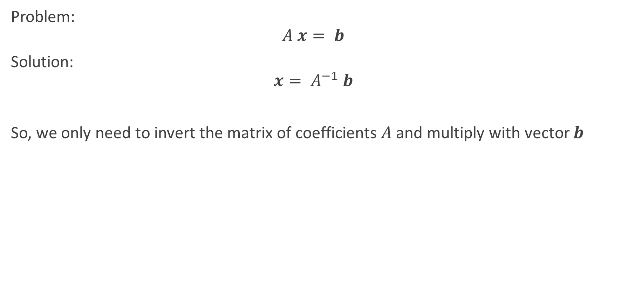
Solving Systems of Linear Equations – cont’d
Notes:
SEE: Moore-Penrose pseudo inverse

Slide 22
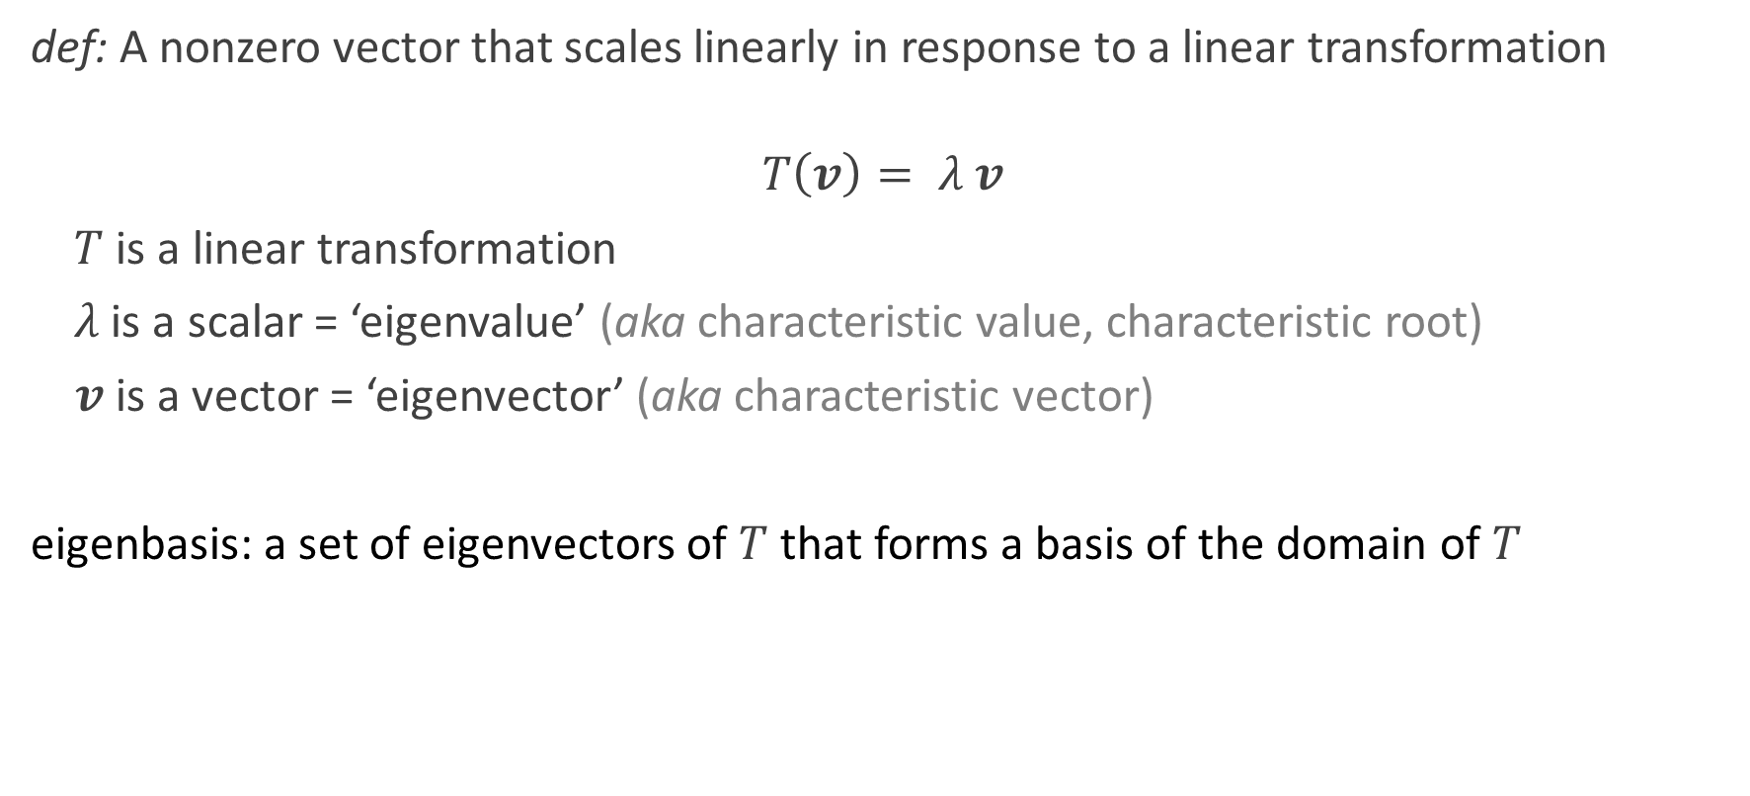
Eigenvalues and Eigenvectors
Notes:
MENTIONS: (1) The energy levels of the electrons of an atom are eigenvalues; their orbits are described by eigenfunctions.
(2) SVD: singular value decomposition. (3) PCA: principal component analysis.
WHITEBOARD: (1) Rotate x axis to separate clusters of points: new axis is 1st eigenvector; new y axis is 2nd eigenvector.
(2) Plot of magnitude vs eigenvalue index follows logarithmic curve.
MENTION: 80:20 rule.

Slide 23
What is bigger than a matrix?
tensor
represented by an n-dimensional array
examples
stress tensor (mechanics)
spacetime tensor (general relativity)
Notes:
MENTION: ‘bigger’ = higher order

Slide 24

Lab 1.1.1: Vector and Matrix Operations
Purpose:
To apply the definitions of vector and matrix operations by designing code that implements them.
Materials:
'Lab 1.1.docx’
See Notebook:
‘Lab 1.1 – Notebook – Linear Algebra’

Slide 25
Calculus
Limits and continuity
Taking derivatives
Integration
Sequences and series

Slide 26
What is Calculus and why is it important for Data Scientists?
Calculus is the mathematical study of continuous change. It is used extensively in many science and engineering domains such as business, economics and medicine.
All key concepts in calculus can be mapped directly to geometrical concepts. For example, differentiation is the slope of a curve and integration is the area under a curve.
Calculus is usually used with linear algebra to find the "best fit" linear approximation for a set of points in a domain. Therefore it is essential for Data Science as it underpins all model optimisation.

Slide 27
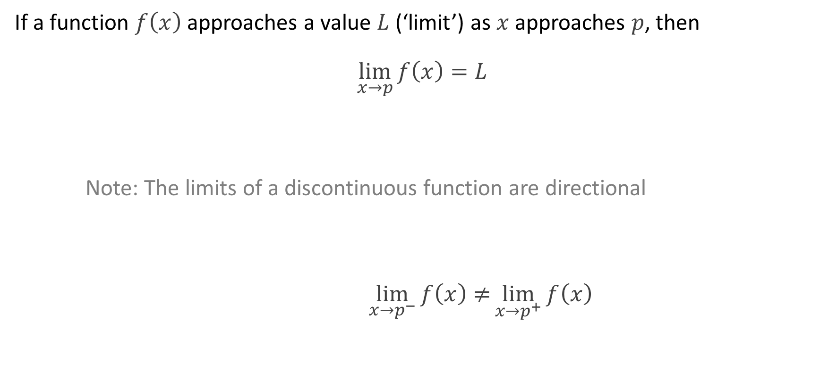
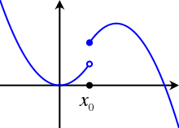

Limits and Continuity
Notes:
MENTIONS: The energy levels of the electrons of an atom are eigenvalues; their orbits are described by eigenfunctions.
WHITEBOARD:

Slide 28
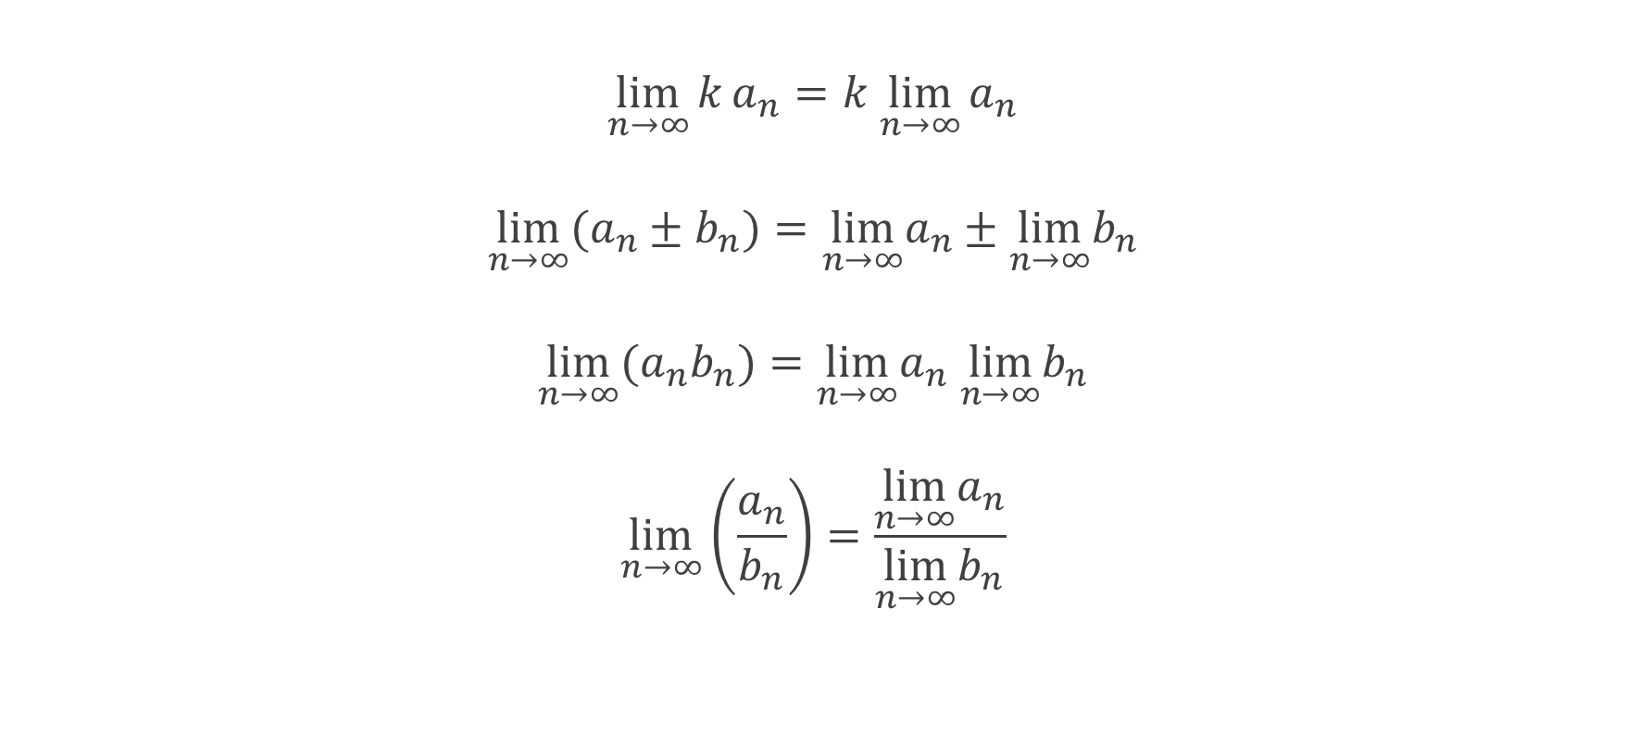
Limit Theorems
Notes:
QUIZ: Which (if any) examples have a limit?

Slide 29
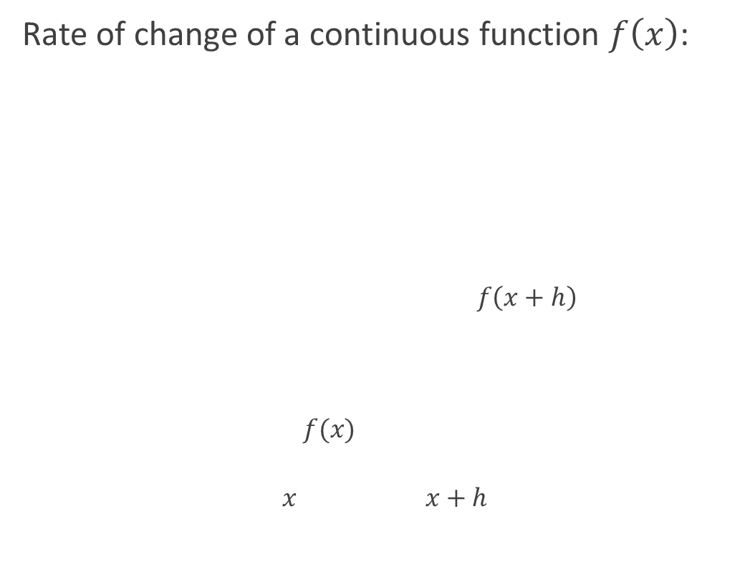
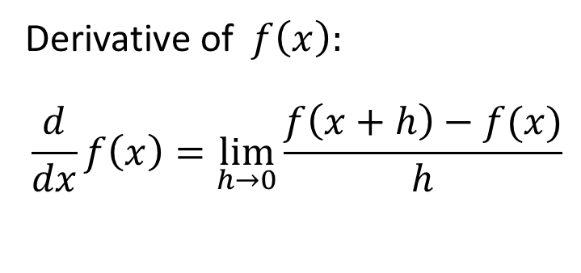
Differentiation
Notes:
WHITEBOARD: Show intermediate calculations (e.g. https://en.wikipedia.org/wiki/Derivative)
QUIZ: (1) If 1st derivative gives slope at each point, what does 2nd derivative give?
(2) The 1st (with respect to time) of displacement is velocity; 2nd is acceleration?
(3) How to compute derivative numerically?
MENTIONS: (1) Steeper slope means more sampling required. (2) Differentiating increases noise in a signal.

Slide 30
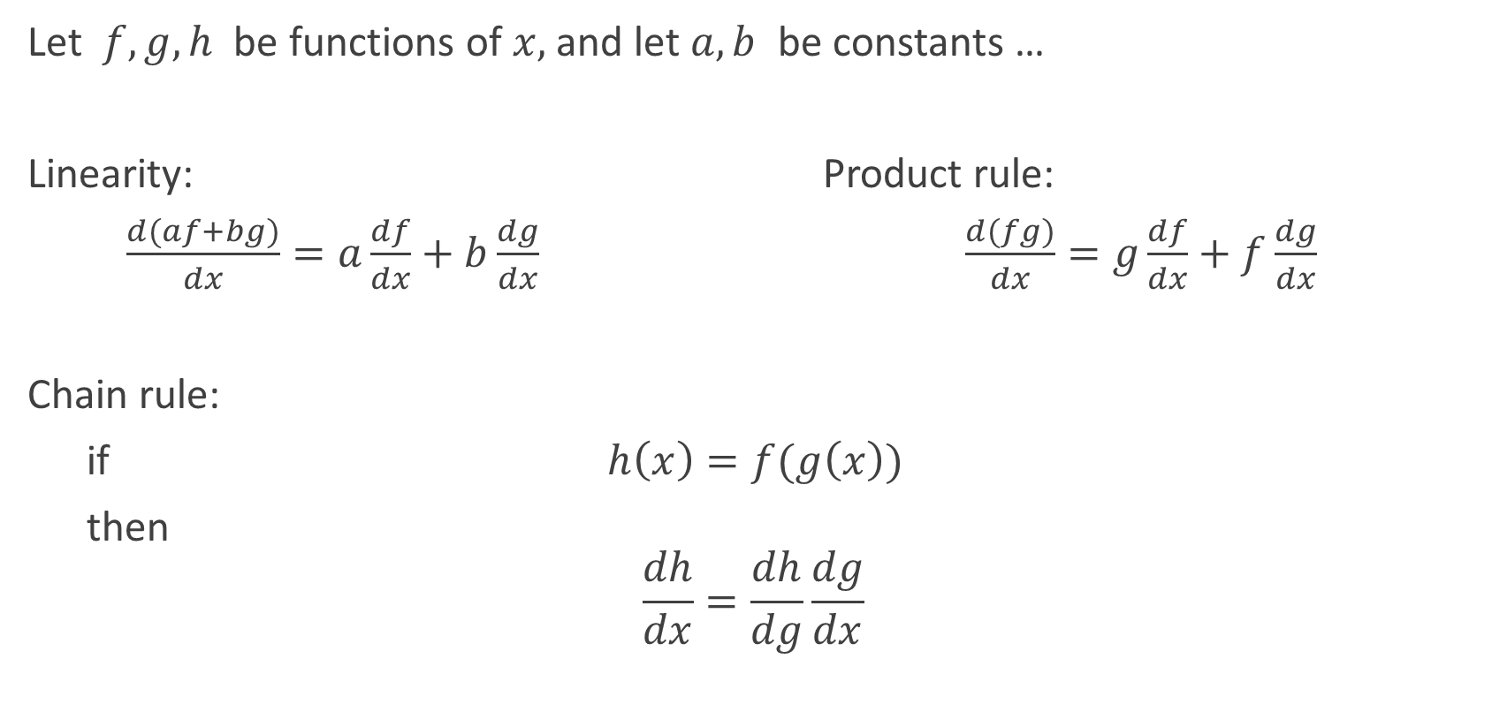
Rules of Differentiation
Notes:
WHITEBOARD: (1) Show intermediate calculations (e.g. https://en.wikipedia.org/wiki/Derivative). (2) Show derivation for a polynomial.
MENTIONS: The derivative (with respect to time) of displacement is velocity.

Slide 31
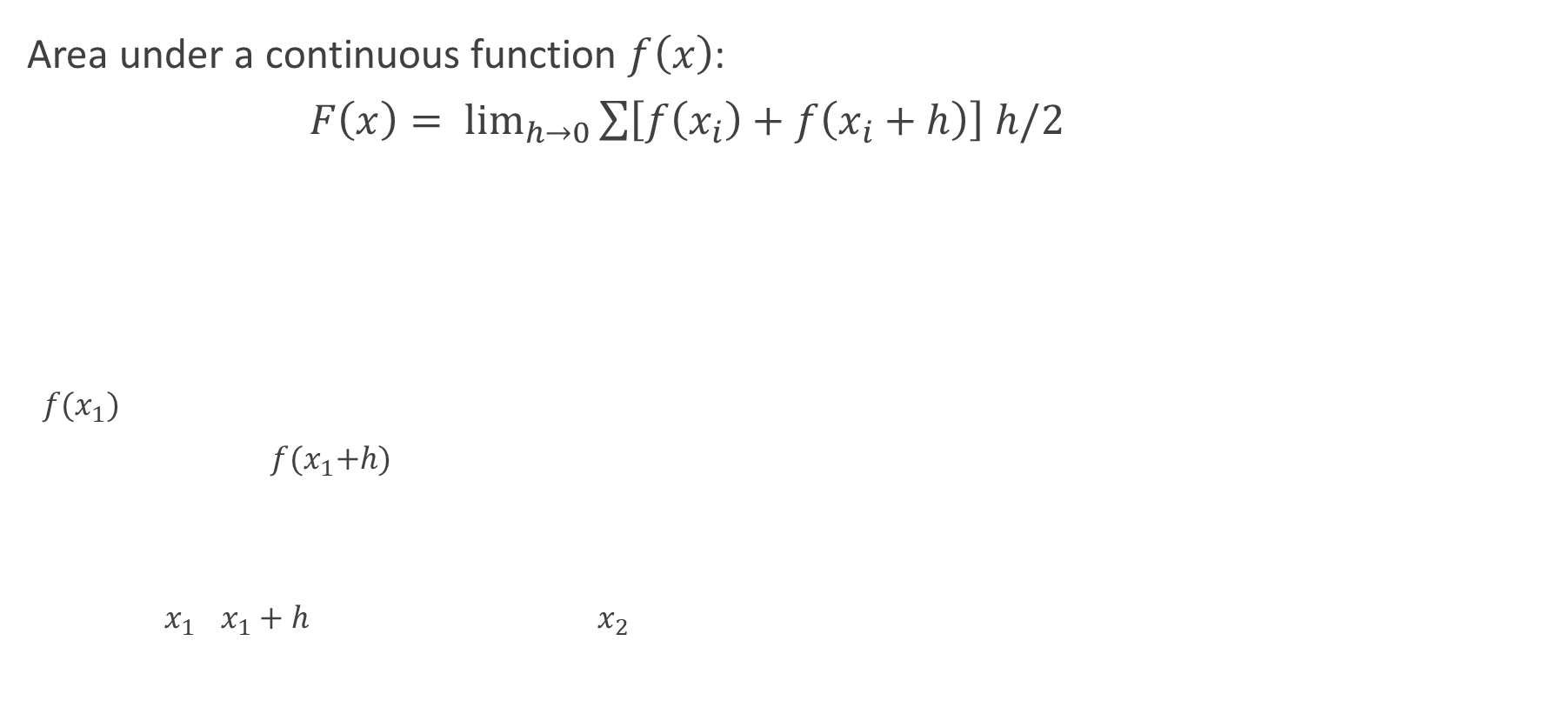
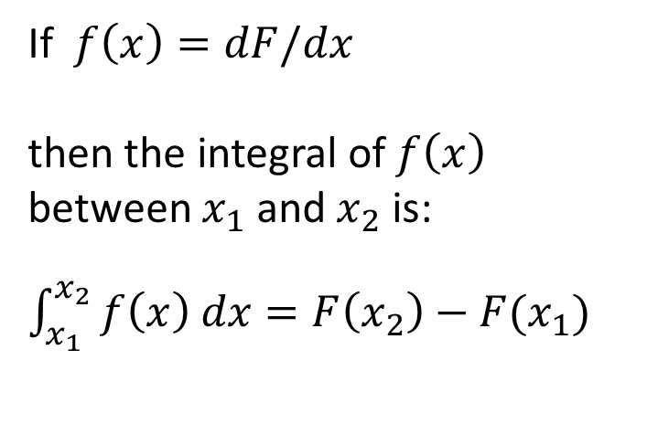
Integration
Notes:
MENTIONS: Integration is a smoothing process. Integral of velocity over time is displacement. Integral of power over time is energy.
QUIZ: How to integrate numerically?
WHITEBOARD: Derive Simpson’s rule.

Slide 32
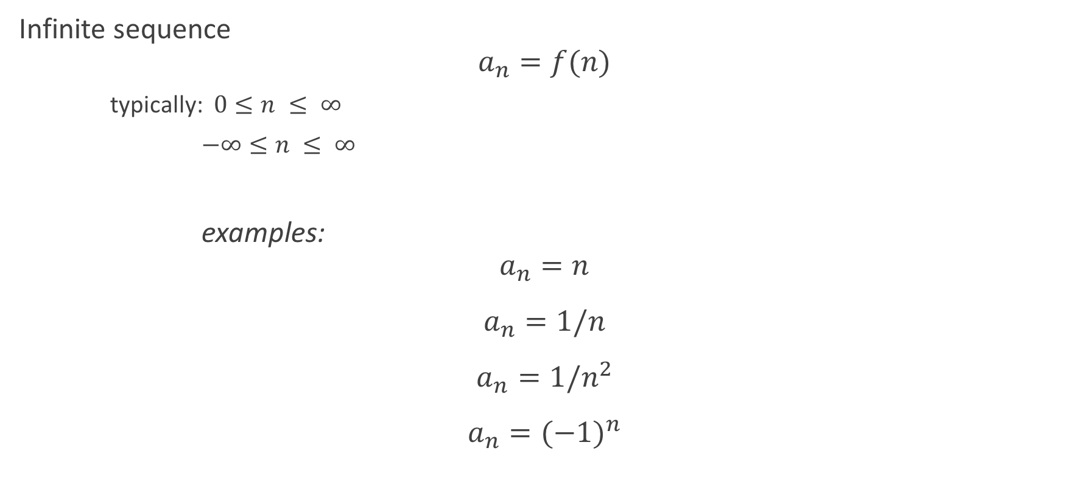
Sequences and Series
Notes:
QUIZ: Which (if any) examples have a limit?
WHITEBOARD: Calculate limit of (4n^2 - 1) / (3n + 2n^2)

Slide 33
Multivariate Calculus
Partial derivatives
Multivariate differentiation
Optimising multivariate functions

Slide 34
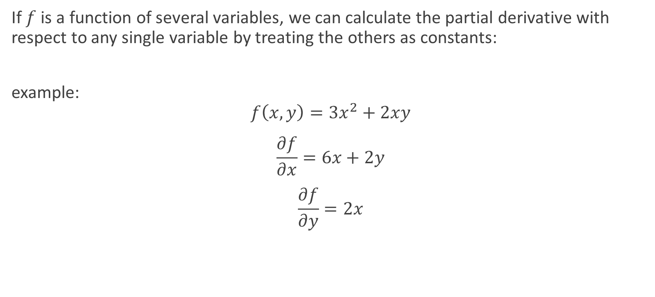
Partial Derivatives

Slide 35
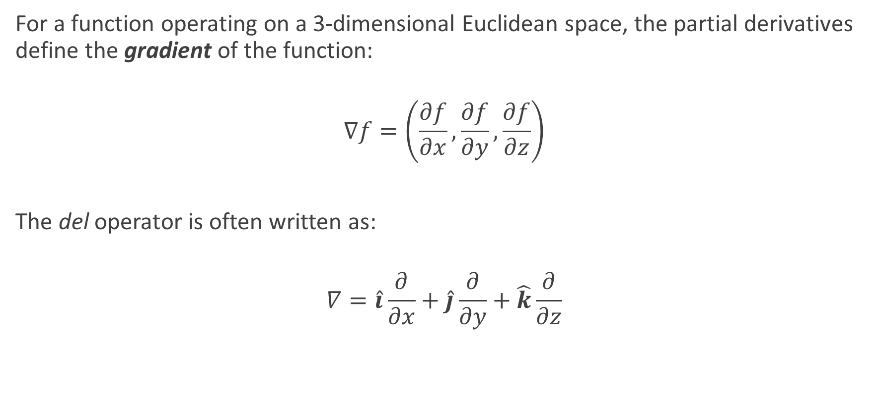
Partial Derivatives – cont’d
Notes:
WHITEBOARD:
MENTIONS: Pressure gradient determines direction of flow.

Slide 36
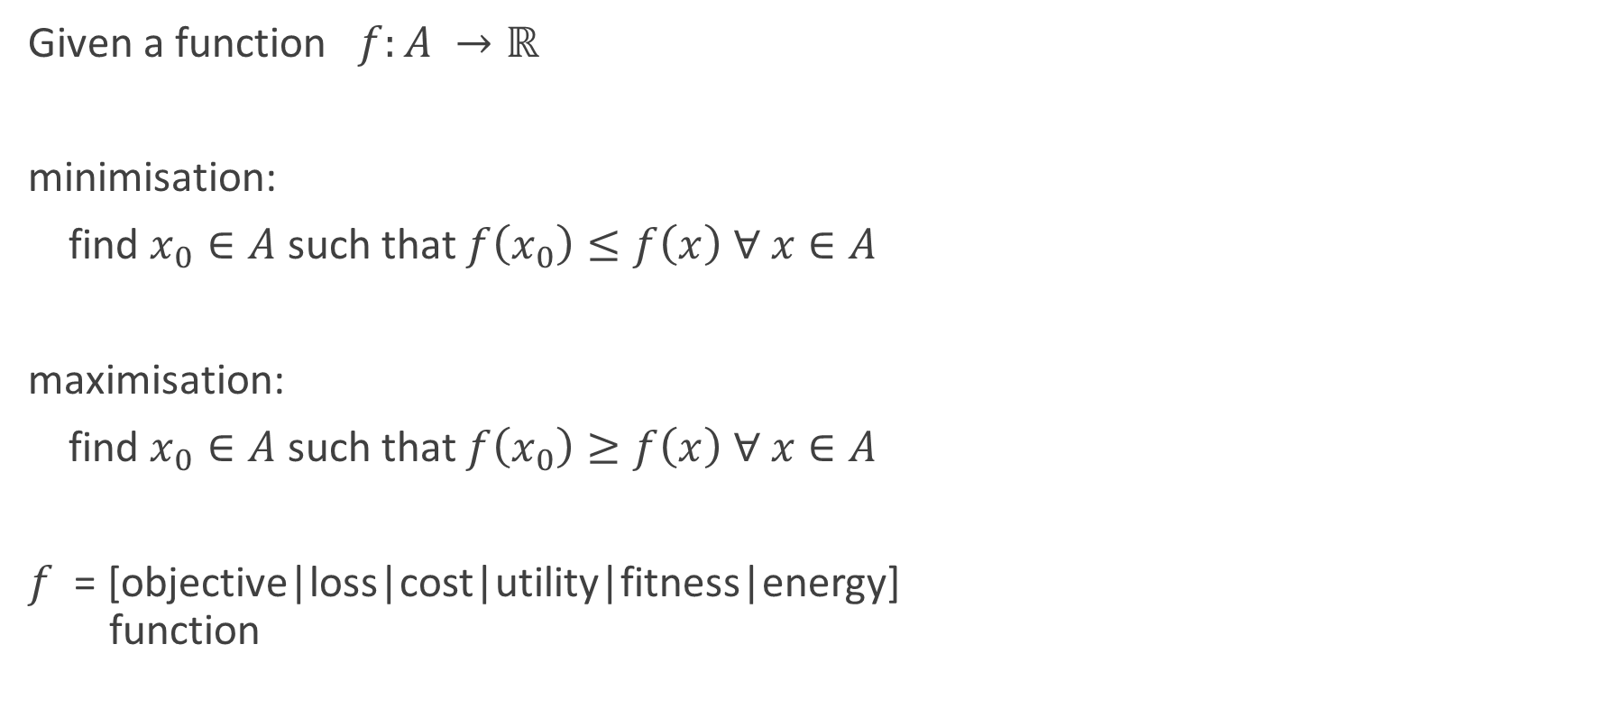
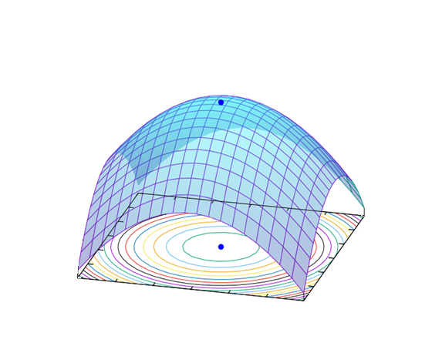
Multivariate Optimisation
Notes:
MENTION: (1) A function with many convolutions will have multiple local minima/maxima; we usually want the global minimum/maximum.
(2) Just as min/max of a function of 1 variable occurs where the derivative is zero, the min/max of a function of multiple variables occurs where the gradient is zero.

Slide 37
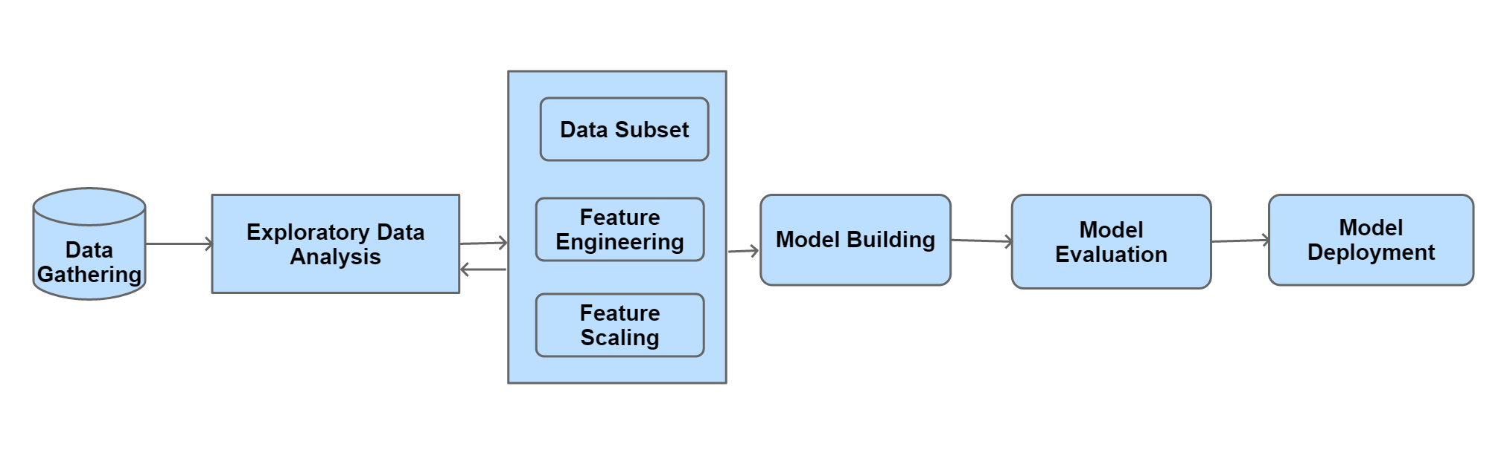
Discussion
Why do data scientists need to be proficient at calculus, infinite series, and linear algebra?
Considering the illustrative Data Science process, where would you use calculus?

Slide 38

Homework: Optimisation
Purpose:
To introduce several methods of multivariate optimisation via working examples.
Materials:
An Interactive Tutorial on Numerical Optimization
https://www.benfrederickson.com/numerical-optimization/
Prepare to discuss:
trade-off: convergence speed vs accuracy
faster convergence requires lower resolution
prefer methods with adaptive resolution

Slide 39
Statistics
Statistical Thinking
Categorical data
Continuous variables
Summarising quantitative data
Modelling data distributions
Confidence intervals
Significance tests and hypothesis testing
Statistical Inference
Analysing one categorical variable
Two-way tables: Analysing categorical data
Distributions in two-way tables

Slide 40
Why statistics is important for a Data Scientist?
Statistical Thinking is an an essential component of a data-driven mindset which is crucial for a Data Scientist
Statistical analysis must start with the appropriate data (sample)
Statistical Inference (reasoning) should start with measurement, ideally, via controlled experiments
Statistics uses samples (a small subset of the population) and therefore always has a degree of uncertainty
Sampling must be random, and preferably, independent
The best way to learn statistics is by experimenting with data using Python code and visualisation

Slide 41
Statistics – Part 1
Analysing categorical data
Analysing one categorical variable
Two-way tables: Analysing categorical data
Distributions in two-way tables

Slide 42
Categorical Variables
Examples
FALSE / TRUE (alt: 0 / 1)
colour
size
class
e.g. species, occupation, degree program, disease category
tier
e.g. age range, income range, frequency range
Notes:
QUIZ: Practical examples (e.g. business)?

Slide 43
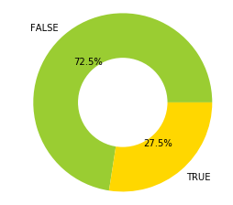
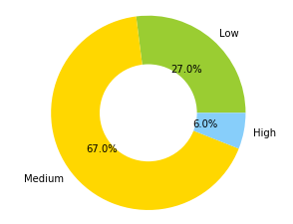
Analysing Categorical Variables
Frequency Tables (aka contingency tables)
category incidence for a single variable within a population
Donut Charts
Income Bracket
Low | 0.27
Medium | 0.67
High | 0.06
Passed Exam
FALSE | 37
TRUE | 14
Notes:
MENTION: Pie charts are out of favour: frequently abused, hard to discern relative proportions.

Slide 44
Analysing Categorical Variables – cont’d
Two-Way Frequency Tables
for a Single Variable within Two Populations
totals row, column: marginal frequencies (aka marginal distribution)
Income Bracket: | Low | Medium | High | Total
Male | 27 | 75 | 6 | 108
Female | 32 | 59 | 3 | 94
TOTAL | 59 | 134 | 9 | 202

Slide 45
Analysing Categorical Variables – cont’d
Dummy Variables (aka dummy coding)
allows categorical variables to be treated like continuous variables
Passed Exam
0 | 37
1 | 14
Treatment | T1 | T2
Control | 0 | 0
Drug 1 | 1 | 0
Drug 2 | 0 | 1
Notes:
QUIZ: Why? (A: So we can apply methods like linear regression)

Slide 46
color | color_red | color_green | color_blue | color_black
red | 1 | 0 | 0 | 0
green | 0 | 1 | 0 | 0
blue | 0 | 0 | 1 | 0
black | 0 | 0 | 0 | 1

Slide 47
Statistics – Part 2
Continuous variables
Summarising quantitative data
Measuring centre in quantitative data: mean, mode, and median
Interquartile range (IQR)
Variance and standard deviation of a population

Slide 48
Continuous Variables
Examples
height
dose
temperature
concentration
revenue
clicks
“Continuous”?
variability is treated as infinite
precision is determined by data acquisition methodology
range usually has practical limits
outliers can be defined statistically or heuristically
frequency (contingency) is not meaningful
Notes:
QUIZ: (1) Practical examples?
(2) If we can’t count individual values, how do we represent the distribution?

Slide 49
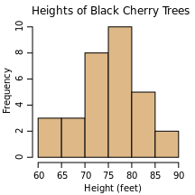
Analysing Continuous Variables
Distribution of binned data:
choose an appropriate bin width
‘cut’ the data into bins
count the number of samples that fall into each bin
what is the resulting plot called?
histogram

Slide 50
Summarising Quantitative Data
Measuring the centre of the data
mean
the average value of the variable
median
the value that separates the 50% lowest values from the rest
mode
the most frequently occurring value
Notes:
QUIZ: How to compute?

Slide 51
Summarising Quantitative Data – cont’d
Quantiles
inverse of binning data for a histogram:
specify proportions of samples we want in each bin
compute bin boundaries that correspond
example: 4 quantiles from a random sample (mean = 0, variance = 1):
Quantile | Boundaries | Count
(0 - 0.25] | (-3.135, -1.61] | 82
(0.25 - 0.50] | (-1.61, -0.0913] | 82
(0.50 - 0.75] | (-0.0913, 1.427] | 82
(0.75 - 1.0] | (1.427, 2.946] | 82

Slide 52
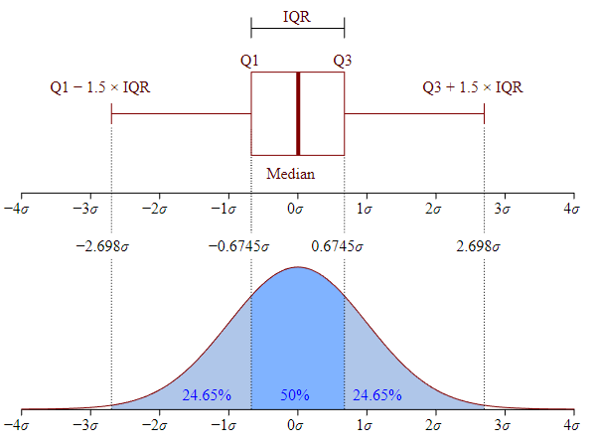
Summarising Quantitative Data – cont’d
Interquartile range (IQR)
IQR = [0.25, 0.75]
box plots are drawn with whiskers extending 1.5 IQR beyond the 0.25 and 0.75 quantiles (i.e. the 1st and 3rd quartiles)
outliers are typically defined as lying outside this range
By Jhguch at en.wikipedia, CC BY-SA 2.5, https://commons.wikimedia.org/w/index.php?curid=14524285

Slide 53
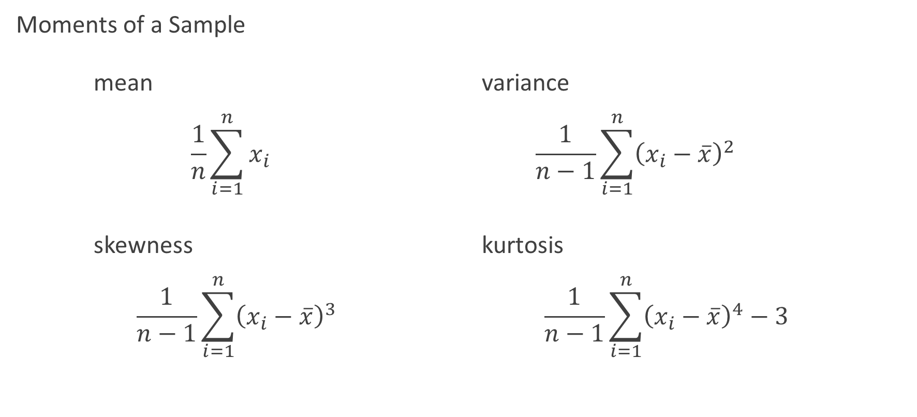
Summarising Quantitative Data – cont’d
Notes:
In probability theory and statistics, skewness is a measure of the asymmetry of the probability distribution of a real-valued random variable about its mean.
The skewness for a normal distribution is zero, and any symmetric data should have a skewness near zero.
Negative values for the skewness indicate data that are skewed left and positive values for the skewness indicate data that are skewed right.
Kurtosis: It measures the amount of probability in the tails. The value is often compared to the kurtosis of the normal distribution, which is equal to 3.
If the kurtosis is greater than 3, then the dataset has heavier tails than a normal distribution (more in the tails).

Slide 54

Lab 1.1.3: Simple data visualisation
Purpose:
Use various plot types to visualise statistical observations.
Materials:
Notebook: ‘Lab 1.1.3 Statistics - part 1 Lab’
Note:
There may not be enough time to complete this lab in the class.
Please complete it as a part of you homework.
This should apply to all labs.

Slide 55
Statistics – Part 3
Modelling data distributions
Percentiles
Z-scores
Density curves
Normal distributions
Notes:
WEEK 1, DAY 3, PART 1

Slide 56
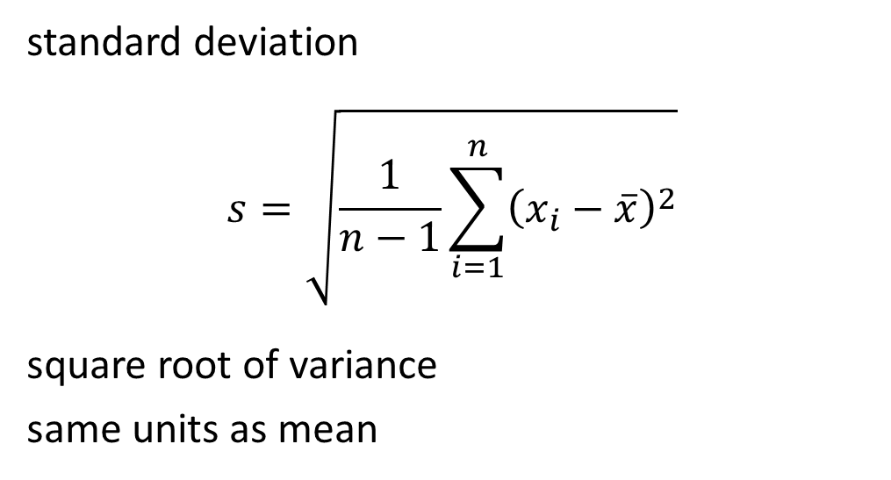
Summarising Quantitative Data – cont’d
Summary statistics

Slide 57
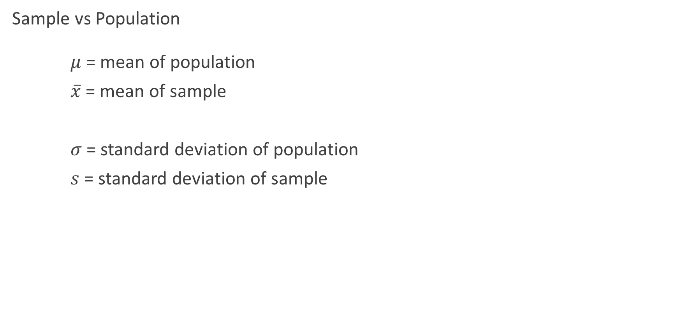
Modelling Data Distributions
Notes:
MENTION: This is not pedantry: the distinctions are important to how we test hypotheses using data.

Slide 58
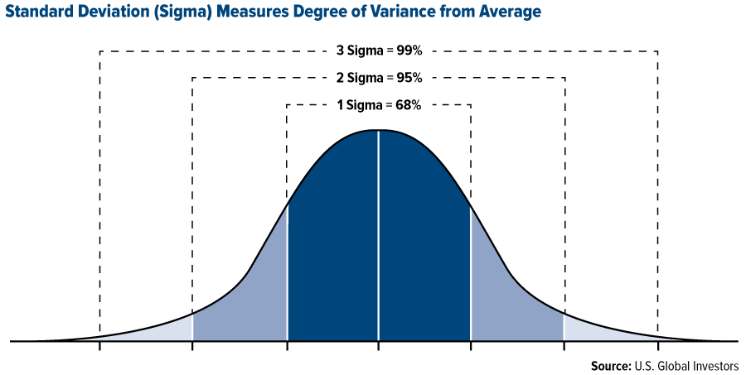
Modelling Data Distributions – cont’d
Mean and Standard Deviation of a Population
Variation
Notes:
MENTION: (1) “Variance” is an unambiguously defined statistical quantity, but most people who say “variance” just mean “variation” or “difference”.
(2) These percentages (here shown rounded to zero decimals) depend on the distribution (this is a ‘normal’ or ‘Gaussian’ distribution).
In statistics, the standard deviation (SD, also represented by the lower case Greek letter sigma σ or the Latin letter s) is a measure that is used to quantify the amount of variation or dispersion of a set of data values.
The formula is easy: it is the square root of the Variance. = The average of the squared differences from the Mean.

Slide 59
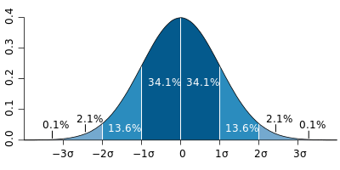
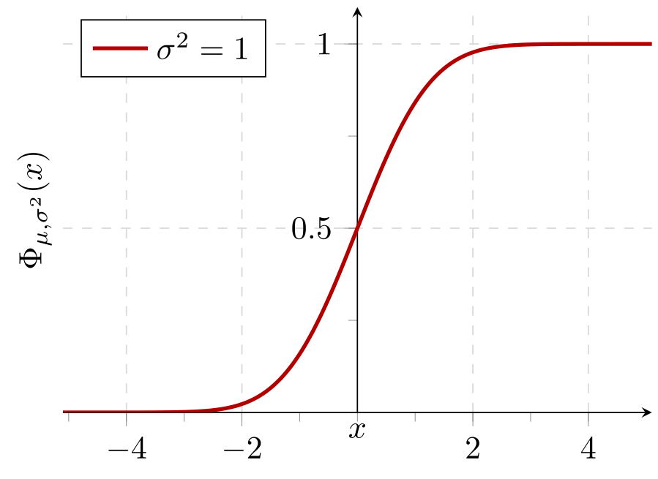
Modelling Data Distributions – cont’d
Probability Density Function Cumulative Probability
By M. W. Toews - Own work, based (in concept) on figure by Jeremy Kemp, on 2005-02-09, CC BY 2.5, https://commons.wikimedia.org/w/index.php?curid=1903871
Notes:
MENTION: (1) +/- 1 SD covers 68.2% of population; 2 covers 95.4%, 3 covers 99.7%.
WHITEBOARD: Percentiles of a distribution.

Slide 60
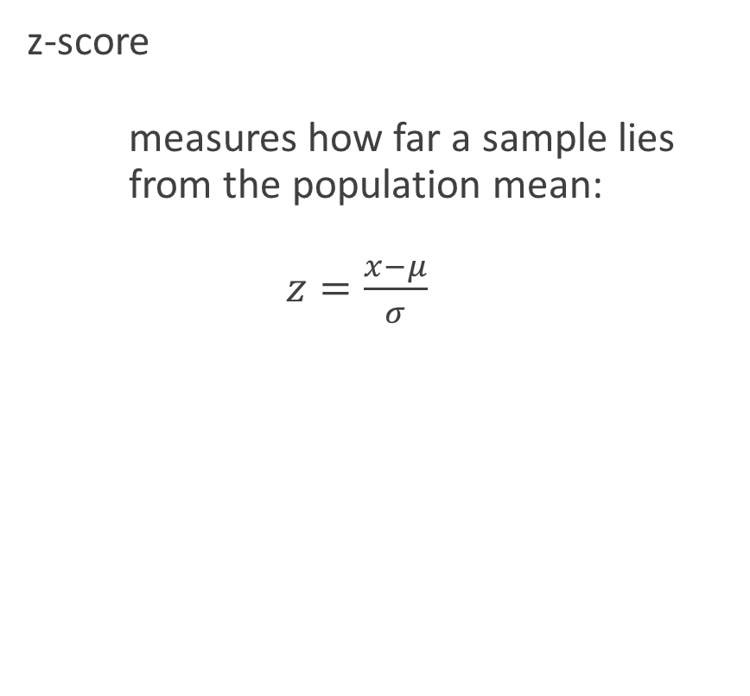
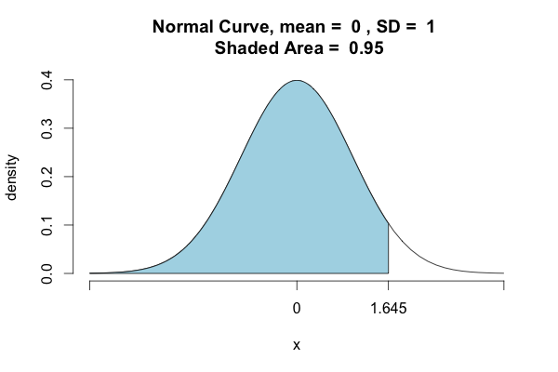
Modelling Data Distributions – cont’d
Notes:
JOKE: As opposed to the ZZZ-score, which measures how boring the lecture is.

Slide 61
Statistics – Part 4
Exploring bivariate numerical data
Scatterplots
Correlation coefficients
Trend lines
Least-squares regression equations
Assessing the fit in least-squares regression

Slide 62
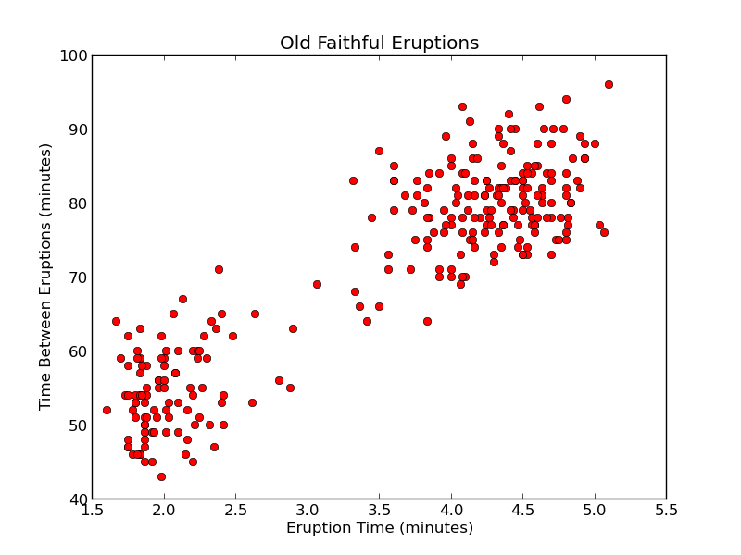
Scatter Plots
2D: plots one variable against another
demonstrates a relation (or lack thereof) between two variables
assumption: data pairs are sampled simultaneously
Notes:
MENTION: This is not pedantry: the distinctions are important to how we test hypotheses using data.

Slide 63
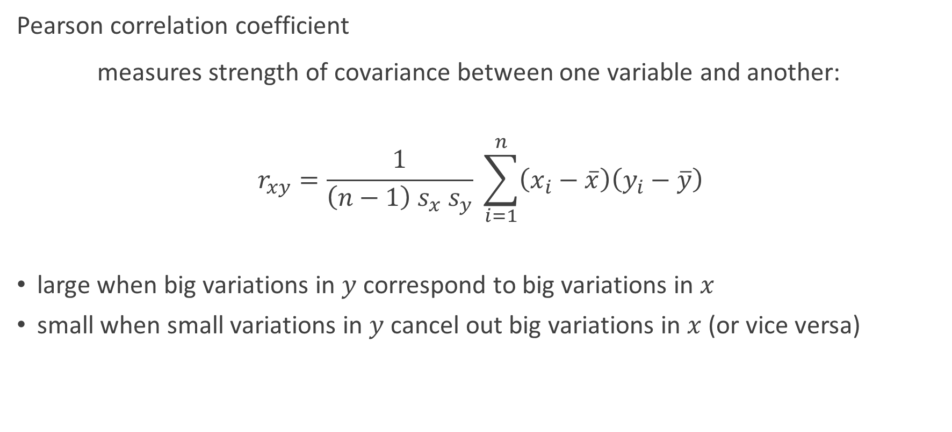
Correlation
Notes:
A correlation matrix is a table showing correlation coefficients between sets of variables. Each random variable (Xi) in the table is correlated with each of the other values in the table (Xj).
This allows you to see which pairs have the highest correlation

Slide 64
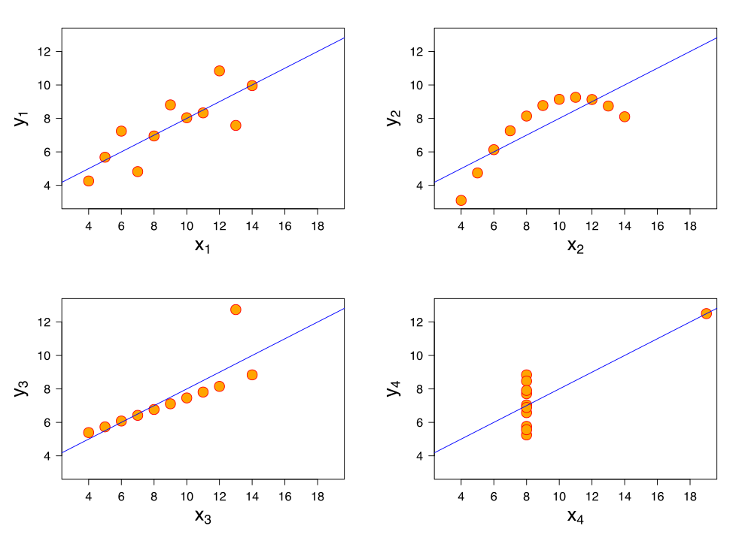
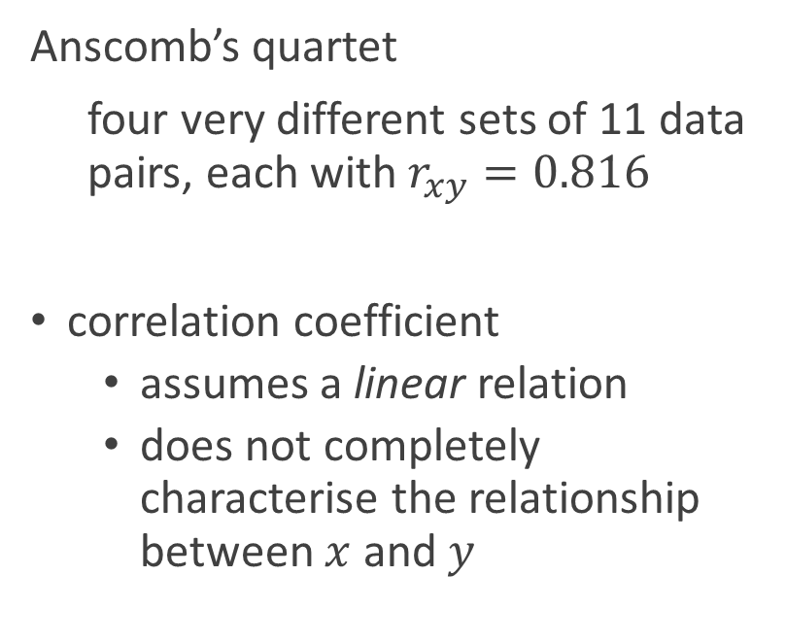
Correlation
By Anscombe.svg: SchutzDerivative works of this file:(label using subscripts): Avenue - Anscombe.svg, CC BY-SA 3.0, https://commons.wikimedia.org/w/index.php?curid=9838454
Notes:
MENTIONS: A famous (if contrived) example of a statistical gotcha.

Slide 65
Trend Lines
best (linear) fit to a 2D scatter plot
the line that minimises error by some criterion
line is specified by
slope
intercept
By Anscombe.svg: SchutzDerivative works of this file:(label using subscripts): Avenue - Anscombe.svg, CC BY-SA 3.0, https://commons.wikimedia.org/w/index.php?curid=9838454
Notes:
MENTIONS: A famous (if contrived) example of a statistical gotcha.

Slide 66
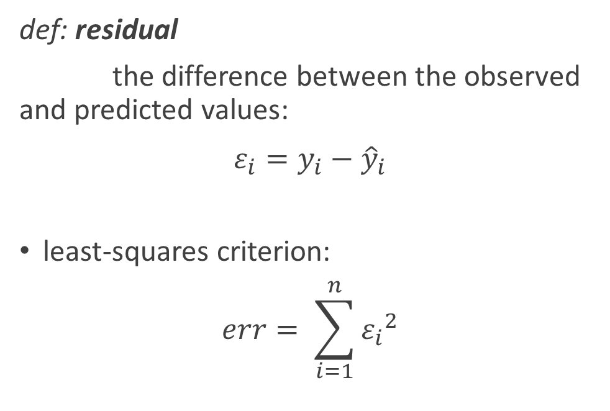
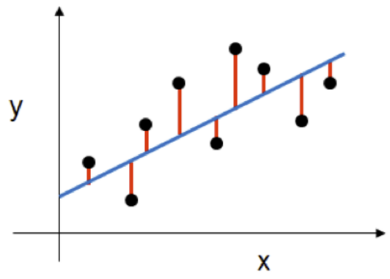
Least-Squares Regression
Notes:
MENTIONS: This error function is highly susceptible to large outliers.

Slide 67
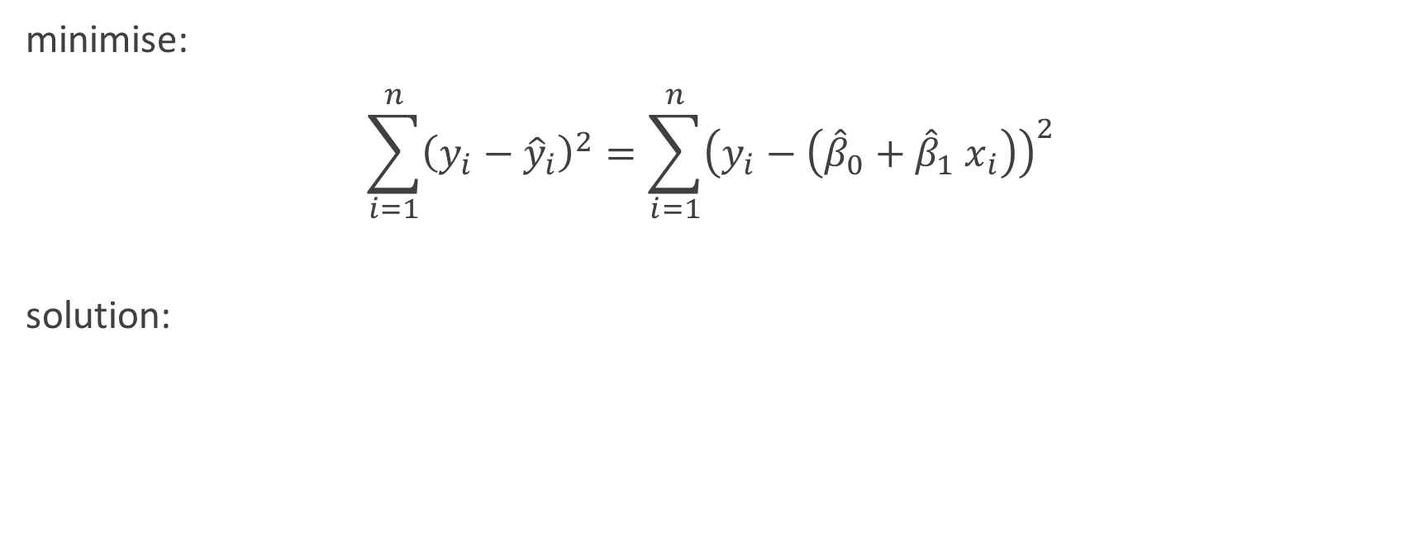
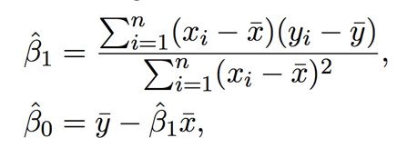
Least-Squares Regression
Notes:
QUIZ: Does anything look familiar?

Slide 68
Statistics – Part 5
Random variables
Discrete random variables
Continuous random variables
Transforming random variables
Combining random variables
Binomial random variables, mean and standard deviation formulas
Geometric random variables
Poisson distribution
The central limit theorem

Slide 69
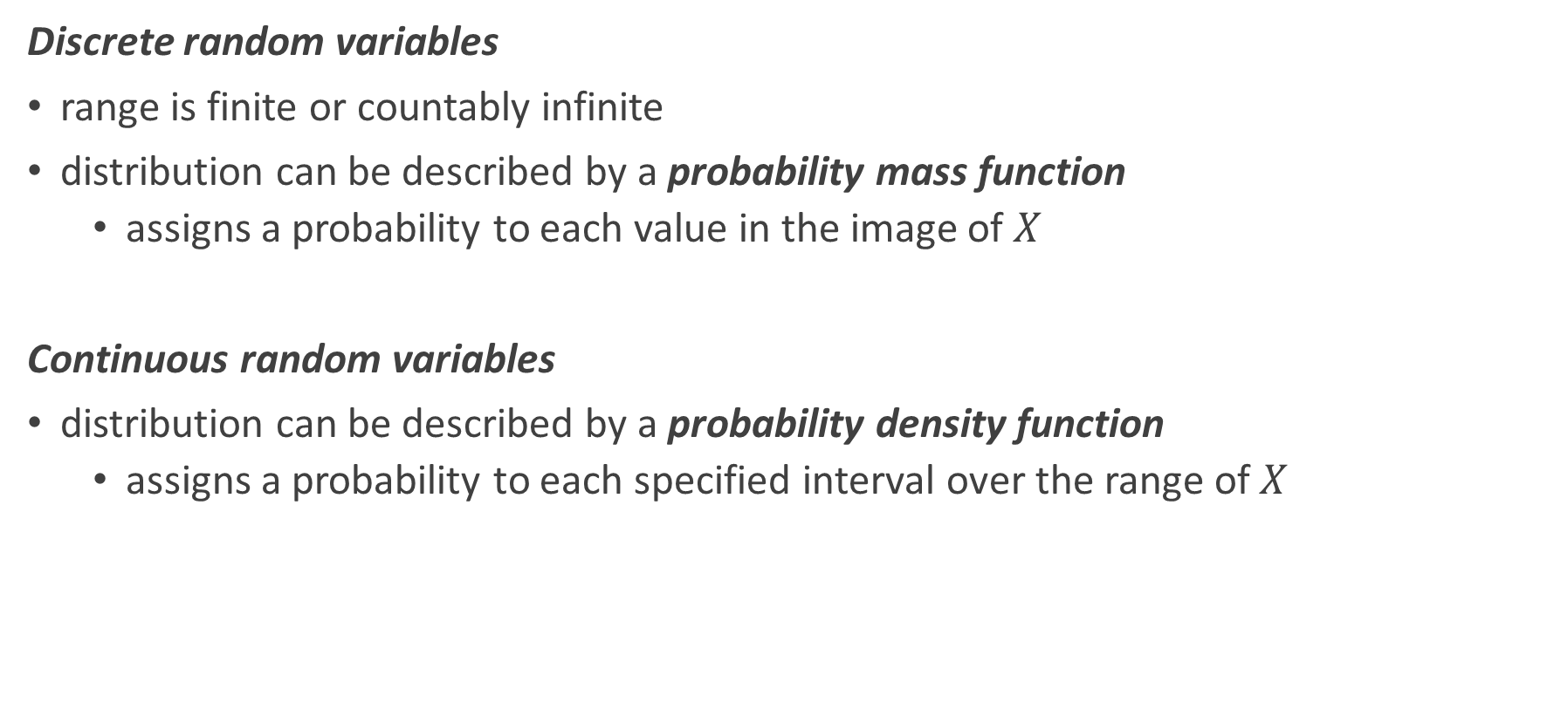
Random Variables
Notes:
A discrete variable is a variable whose value is obtained by counting. A discrete random variable X has a countable number of possible values.
Examples: number of students present. number of red marbles in a jar
A continuous variable is a variable whose value is obtained by measuring.
Examples: height of students in class, weight of students in class
A random variable is a variable whose value is a numerical outcome of a random phenomenon.

Slide 70
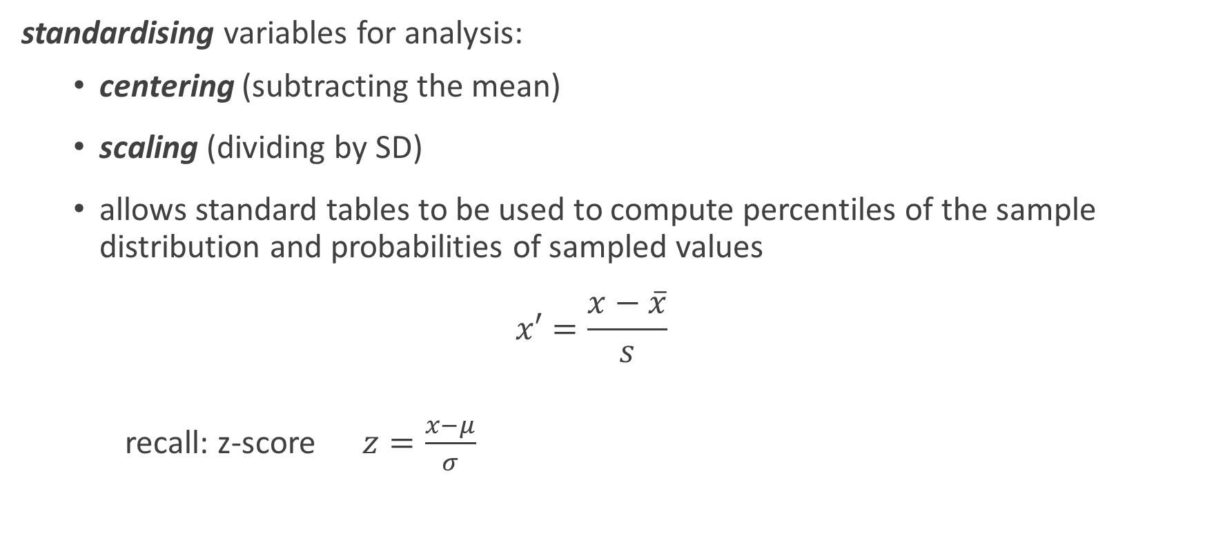
Transforming random variables
Notes:
QUIZ: Does x’ look familiar?
FLY-IN: Answer: z-score.
JOKE: As opposed to the ZZZ-score, which measures how boring the lecture is.

Slide 71

Transforming random variables – cont’d

Slide 72

Transforming random variables – cont’d

Slide 73

Transforming random variables – cont’d
Notes:
In statistics, a power transform is a family of functions that are applied to create a monotonic transformation of data using power functions. This is a useful data transformation technique used to stabilize variance, make the data more normal distribution-like, improve the validity of measures of association such as the Pearson correlation between variables and for other data stabilization procedures.

Slide 74




Normal Distribution
By Inductiveload - self-made, Mathematica, Inkscape, Public Domain, https://commons.wikimedia.org/w/index.php?curid=3817954
Notes:
Probability Distribution Function
MENTION: CDF is the integral of PDF.
QUIZ: What does this mean? (A: value of CDF(x) is area under PDF up to x = probability that a sample of x or less will be drawn randomly from distribution.)

Slide 75
Other types of Probability Distributions
Bernoulli distribution
The outcome of a single Bernoulli trial (e.g. success/failure, yes/no)
Binomial distribution
The number of "positive occurrences" (e.g. successes, yes votes, etc.) given a fixed total number of independent occurrences
Geometric distribution
Binomial-type observations but where the quantity of interest is the number of failures before the first success; a special case of the negative binomial distribution

Slide 76
Statistics – Part 6
Confidence intervals
Significance tests and hypothesis testing
Inference
ANOVA

Slide 77


p-Value

Slide 78

Confidence Intervals
mean ± | % population
1 σ | 68.2
2 σ | 95.4
3 σ | 99.7

Slide 79
Confidence Intervals – cont’d
We define confidence intervals in terms of target probability bands:
confidence interval | mean ± | p-value
0.68 | ∼1 σ | 0.32
0.95 | ∼2 σ | 0.05
0.99 | ∼3 σ | 0.01

Slide 80

Significance Tests
Notes:
MENTION: (1) +/- 1 SD covers 68.2% of population; 2 covers 95.4%, 3 covers 99.7%.
WHITEBOARD: Percentiles of a distribution.

Slide 81


One-Tailed Test vs Two-Tailed Test
One-tailed test: is B greater than A?
a 95% confidence interval would mean we are interested in the last 5% of the right tail
Nb. for “Is B less than A” we would be looking at the left tail instead of the right.
Two-tailed test: is B different from A?
a 95% confidence interval would mean we are interested in the last 2.5% of each tail
standard normal distribution

Slide 82

Standard Error of the Mean
Notes:
MENTION: We apply the t-test in the same way as the z-test, but we get smaller confidence intervals.

Slide 83

Student’s t-Test
Notes:
MENTION: We apply the t-test in the same way as the z-test, but we get smaller confidence intervals.

Slide 84
Null Hypothesis
If we want to test whether B is different from A, we first assume that it is not.
Then we test to see if the difference between A and B is likely to occur by random chance.
If the difference between A and B exceeds the confidence interval, we reject the null hypothesis and infer that B is not from the same population.

Slide 85
ANOVA
For comparing multiple groups, repeated application of the t-test would randomly give rise to apparent significance
ANOVA avoids this error by introducing the F-test (analogous to the t-test but for more than 2 groups)
You can use SciPy to estimate variations between two or more groups
Notes:
WHITEBOARD: Overlapping distributions.

Slide 86
Probability
Basic theoretical probability
Bayesian inference
Probability using sample spaces
Basic set operations
Permutations and combinations
Conditional probability and independence

Slide 87

Probability

Slide 88

Sample Space
Notes:
QUIZ: (1) What is the sample space of an expt in which two coins are tossed? A: {HH, HT, TH, TT}
(2) WHITEBOARD: Expt in which 2 dice thrown: sigma = 36 x (D1, D2). Event A = 5: n = 4.

Slide 89






Set Operations

Slide 90

Permutations and Combinations
Notes:
QUIZ: How are P(n,k) and C(n,k) related?

Slide 91
Bayes’ inference theorem
Bayes’ inference theorem used to update the probability for a hypothesis as more evidence or information becomes available.
Theorem:
P(H|E) = P(E|H).P(H)/P(E)
Definition:
P(H|E): The probability of a event H given E

Slide 92
Lab 1.1.4: Applying statistical thinking using Python
Purpose:
Explore how to use Python (and related packages) to apply Statistical Thinking on data.
Materials:
Notebook: ‘Lab 1.1.4 Statistics - part 2 Lab’
Note:
The may not be enough time to complete this lab in the class.
Please complete it as a part of you homework.
This should apply to all labs.

Slide 93
Questions?

Slide 94
End of Presentation!

